Slide 1



Distributed Shared Persistent Memory
Yizhou Shan, Shin-Yeh Tsai, Yiying Zhang
Purdue University
Notes:
Thank you for the introduction. Good morning everyone, my name is Yizhou Shan. Today I’m going to introduce our work on distributed shared persistent memory. This is a joint work with Shin-Yeh, and my advisor Prof. Yiying Zhang.

Slide 2
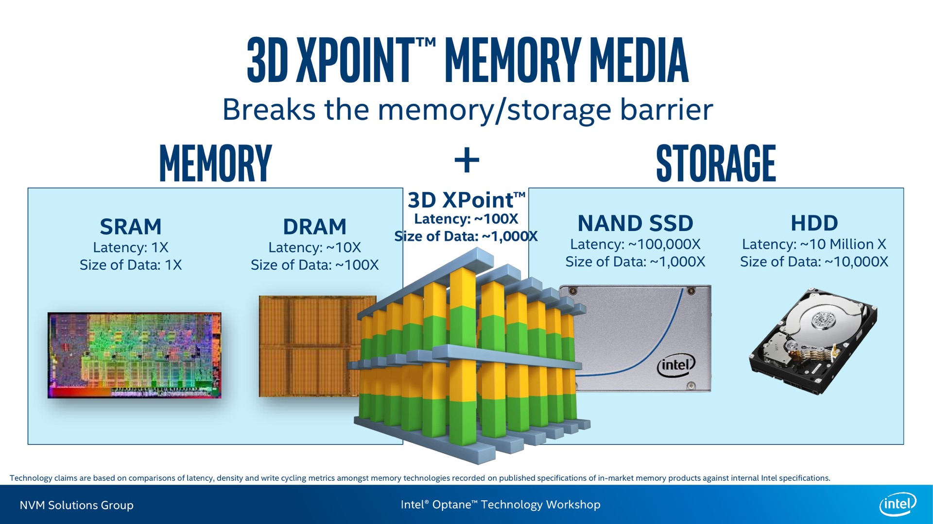
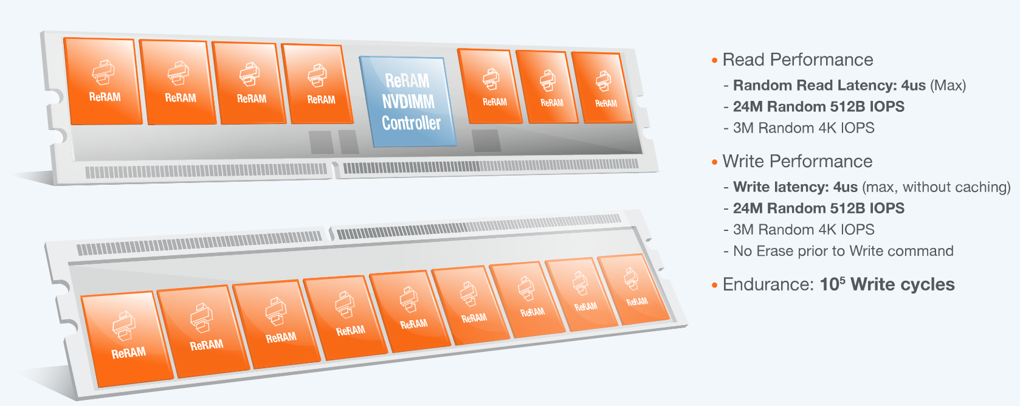
Persistent Memory (PM/NVM)
Byte Addressable
Low Latency
Persistent
Capacity
Less $
CPU
Cache
PM
DRAM
Notes:
Today we are in a very exciting time, people have been talking about non-volatile memory for a long time, and finally the time Is coming.
Intel has released 3D-Crosspoint based SSD, and Crossbar also announced RE-RAM based NVDIMM.
Non-volatile memory is byte-addressable, and it can handle persistent data access at very low-latency. It also offers us higher density and will probably reduce the deploy cost.
Persistent memory or PM is the form when we attach NVM directly into the main-memory bus, like DRAM. Applications can access PM directly via load/store without any software overhead. And this is the model our system is built on. Today we are in a very exciting time, people have been talking about non-volatile memory for a long time, and finally the time has come (winter is coming?). Intel has released 3D-Crosspoint based SSD, and Crossbar also announced RE-RAM based NVDIMM.
Non-volatile memory is byte-addressable, and it can handle persistent data access at very low-latency. It also offers us higher density and will probably reduce the deploy cost.
Persistent memory is the form when we attach NVM directly into the main-memory bus. And this is the model our system is built on.

Slide 3
PMFS
[SOSP’09]
Memory Persistency
[ISCA’14]
BPFS
[SOSP’09]
SCMFS
[SC’11]
Mnemosyne
[ASPLOS’11]
HiNFS
[EuroSys’16]
NV-Heap
[ASPLOS’11]
NVWAL
[ASPLOS’16]
Kamino-Tx
[EuroSys’17]
SCT/DCT
[ASPLOS’16]
Notes:
In the past few years, there have been a lot great research work about PM. There are PM-based filesystems, PM-based heaps, PM-based transaction and loggings systems. However, all those previous work are on a single machine environment.

Slide 4
Moving PM into Datacenters
PM fits datacenter
Datacenter applications require a lot memory
Datacenter applications need to access a lot data fast
Limited research work
Mojim [ASPLOS’15]
Octopus [ATC’17]
Challenges
Handle node failure
Ensure good performance
Easy-to-use abstraction
Notes:
Mojim was our previous work on providing efficient PM replication and Octopus is a work published this year that builds a pm-based dist fs.
These works took initial steps towards using PM in datacetners, but they did not solve all the problems. In datacenters, things will fail. When failure happens, software need to ensure that user data is safe and can still be accessed.

Slide 5
Distributed Shared Persistent Memory (DSPM)
A significant step towards
using PM in datacenters
Notes:
We took a significant step towards using PM in datacenters by proposing a new model called: Distributed Shared Persistent Memory, or DSPM.
You may wonder what DSPM is. From the name, you can see something familiar that you already know, which is Distributed Shared Memory.
DSM is a popular concept back in 90s.

Slide 6
DSPM
Native Memory Load/Store
Local or remote (transparent)
Pointers and in-memory data structures
Memory Sharing
Notes:
So, like DSM, DSPM also supports native memory load/store, it also allows memory sharing.
Then what is different here? Yes, Persistent. Adding persistence means adding 2 more requirements. First, persistence means we need a way to name the data, so DSPM needs persistent naming. Second, adding persistence means we need to make sure even things fail, the data is still safe and can be accessed, that is why DSPM needs to provide data durability and reliability guarantees.

Slide 7
Distributed Shared Persistent Memory (DSPM)
A significant step towards
using PM in datacenters
Notes:
Then what is different here? Yes, Persistent. Adding persistence means adding 2 more requirements. First, persistence means we need a way to name the data, so DSPM needs persistent naming. Second, adding persistence means we need to make sure even things fail, the data is still safe and can be accessed, that is why DSPM needs to provide data durability and reliability guarantees.

Slide 8
DSPM
Direct Memory Load/Store
Local or remote (transparent)
Pointers and in-memory data structures
Memory Sharing
Persistent Naming
Data Durability and Reliability
Notes:
So what is different here? Yes, Persistent. Adding persistence means adding 2 more requirements. First, persistence means we need a way to name the data, so DSPM needs persistent naming. Second, adding persistence means we need to make sure even things fail, the data is still safe. That is why DSPM needs to provide data durability and reliability guarantees.
The above used to be taken care of by distributed shared memory, and the bottom half used to be taken care of by distributed storage systems. The reason why they are built separately is because early we only have DRAM and Disk. Now the hardware supports these 2 things at the same time, so we believe the software should also support this in one layer. That is our main idea of building DSPM model, that is using one layer to integrate both distributed memory and distributed storage. No extra layers, no more data marshaling/unmarshali­ng.

Slide 9
DSPM
DSPM Design Principle:
One Layer Approach
Direct Memory Load/Store
Local or remote (transparent)
Pointers and in-memory data structures
Memory Sharing
Distributed Memory
Distributed Storage
Persistent Naming
Data Durability and Reliability
Notes:
So, like DSM, DSPM also supports direct memory load/store, it also allows memory sharing.
So what is different here? Yes, Persistent. Adding persistence means adding 2 more requirements. First, persistence means we need a way to name the data, so DSPM needs persistent naming. Second, adding persistence means we need to make sure even things fail, the data is still safe and can be accessed, that is why DSPM needs to provide data durability and reliability guarantees.
The above used to be taken care of by distributed shared memory, and the bottom half used to be taken care of by distributed storage systems. The reason why they are built separately is because before PM has come, we only have DRAM and storage devices. Now PM, the hardware supports these 2 things at the same time, so we believe that the software should also support them together. With this, we come to our design principle. That is using only one layer to integrate both distributed memory and distributed storage. No extra layers, no more data marshaling/unmarshali­ng.

Slide 10
DSPM Usages
Scale out single-node PM-based systems easily
Port storage systems to DSPM to improve performance
Add data durability to memory-based applications
Notes:
Now we understand DSPM at a high-level. How can datacenter applications or systems benefit from it? By using DSPM, single-node PM-based systems can scale out easily. Moreover, distributed storage systems can migrate to DSPM to improve performance. Even for memory-based systems, they can add durability to easily do checkpoint during a long-run.

Slide 11

Hotpot: A Kernel-Level RDMA-Based DSPM System
Open-Source
Easy-to-Use
Native Load/Store
Persistent Naming
Flexible Consistency Levels
Data Durability & Reliability
Notes:
To exploit the full potential of DSPM, we built Hotpot, an open-source kernel-level, RDMA-based DSPM system. It is very easy-to-use, it provides the benefits of both distributed shared memory and distributed storage systems. Hotpot also provides flexible consistency levels with guaranteed data reliability.

Slide 12
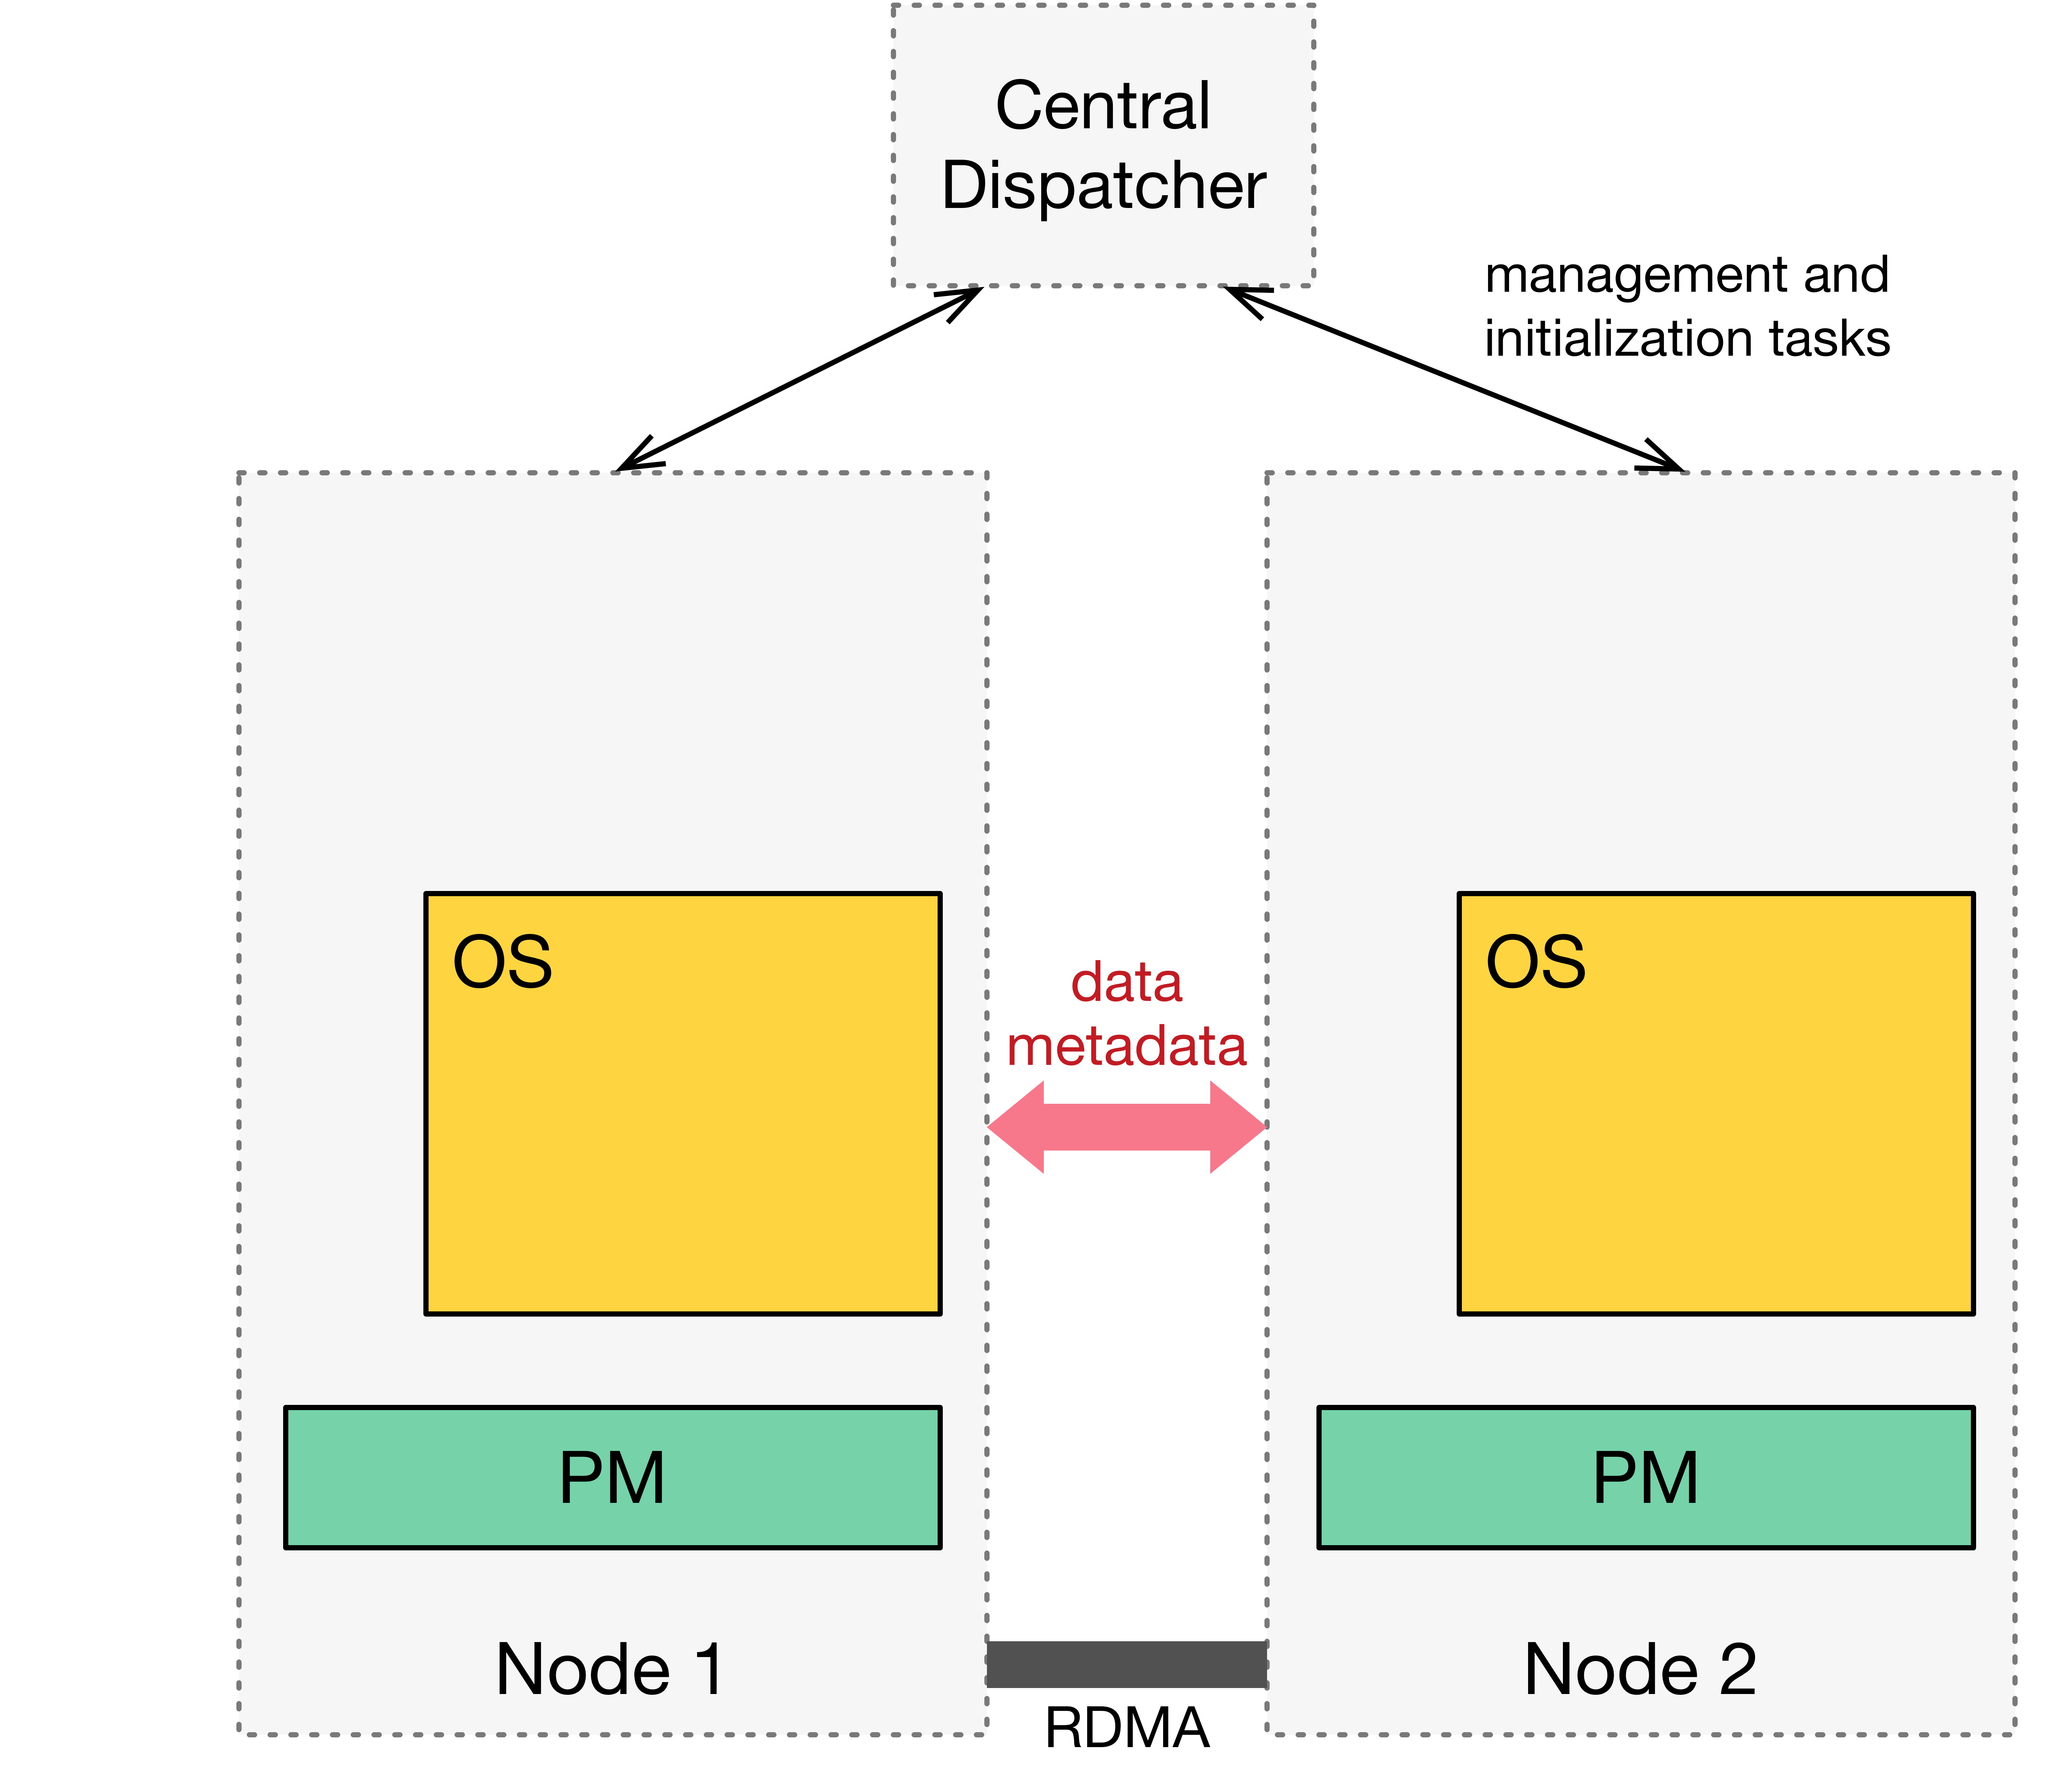
Hotpot Architecture
Notes:
The hotpot cluster consists of a set of hotpot nodes equipped with PM, and a central-dispatcher. The CD only performs node membership management and task initialization. But all the data and metadata communications happen only among hotpot nodes.

Slide 13
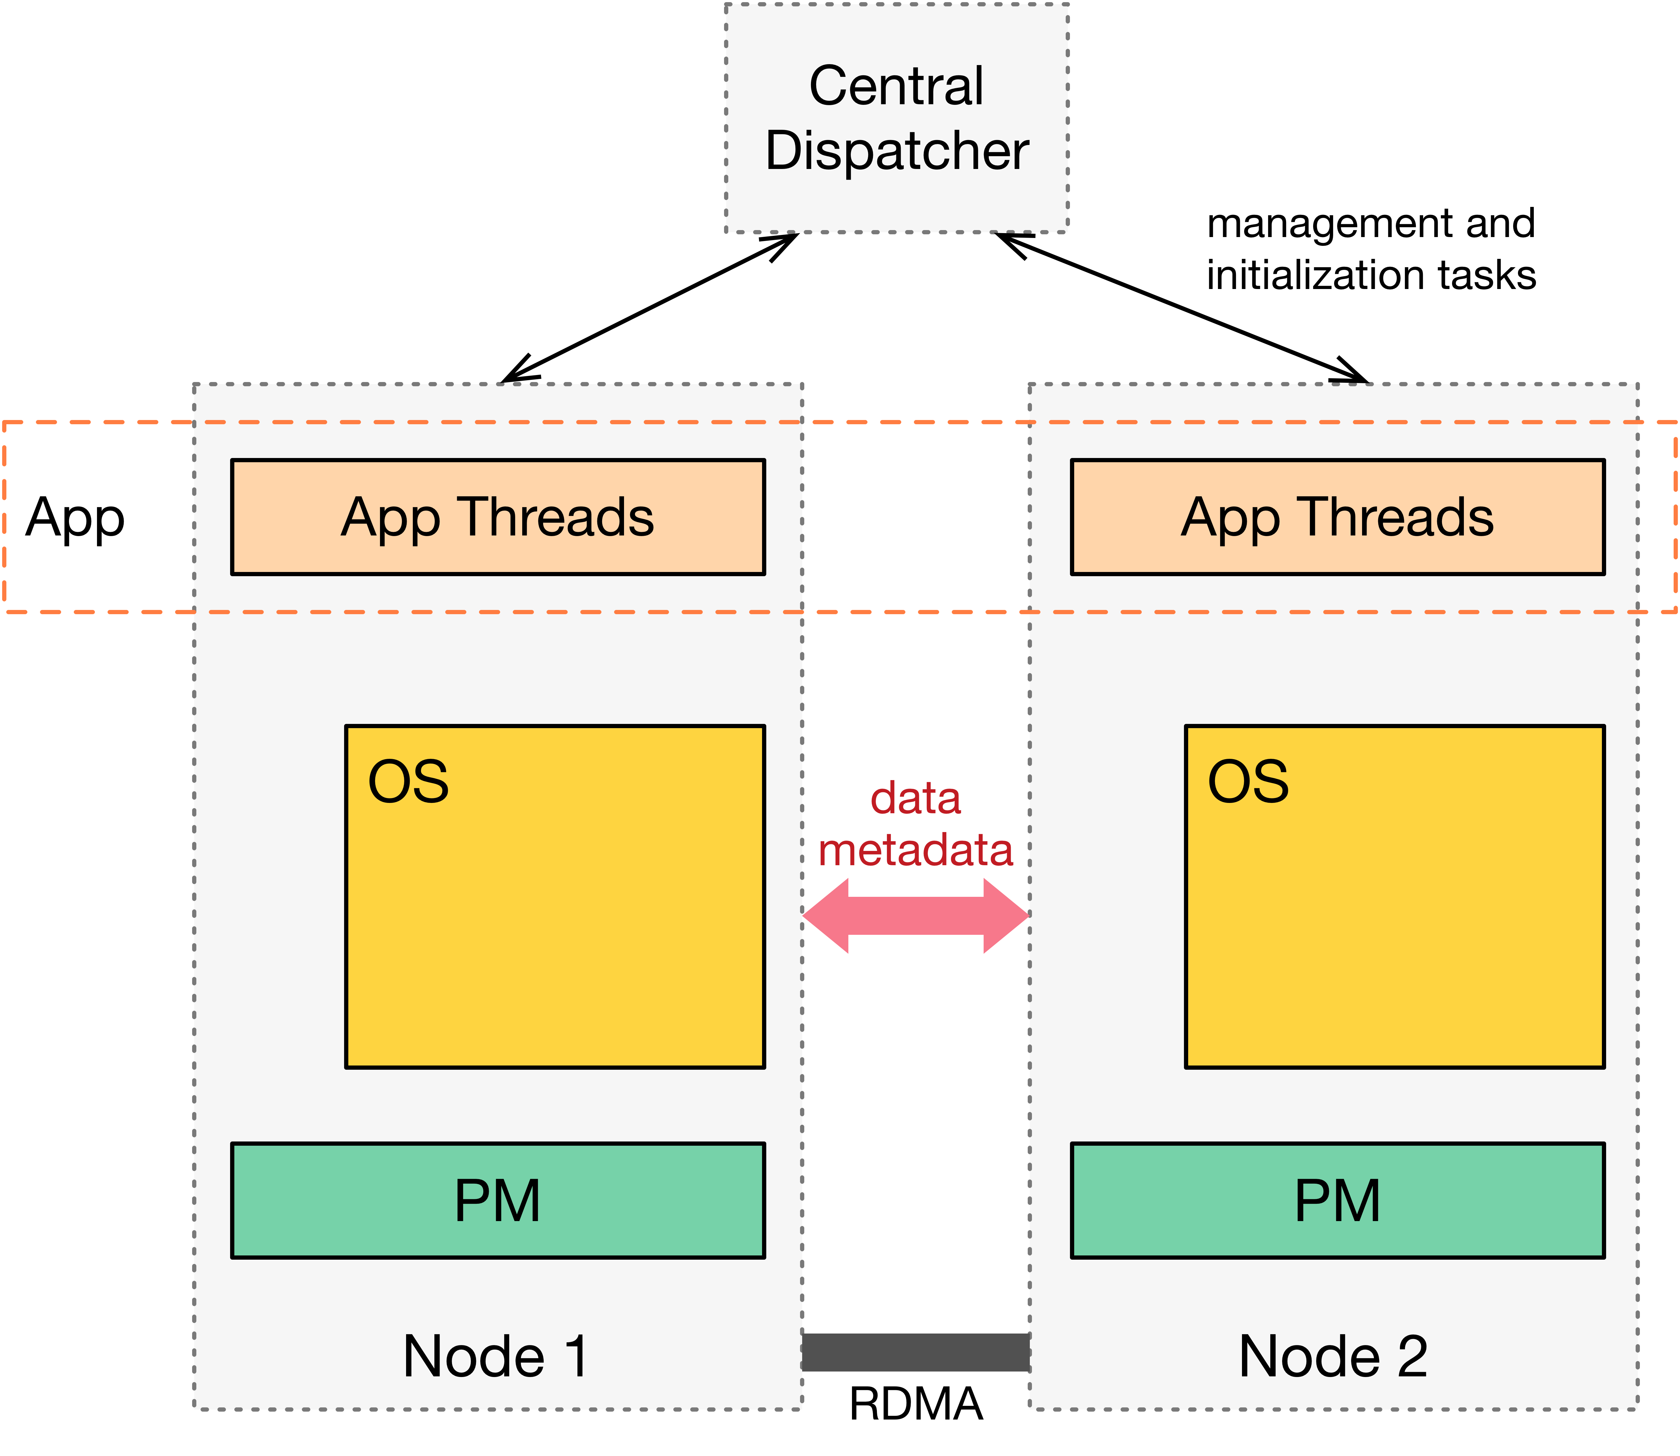
Hotpot Architecture
Notes:
Applications themselves decide what computation they want to run on each node.

Slide 14
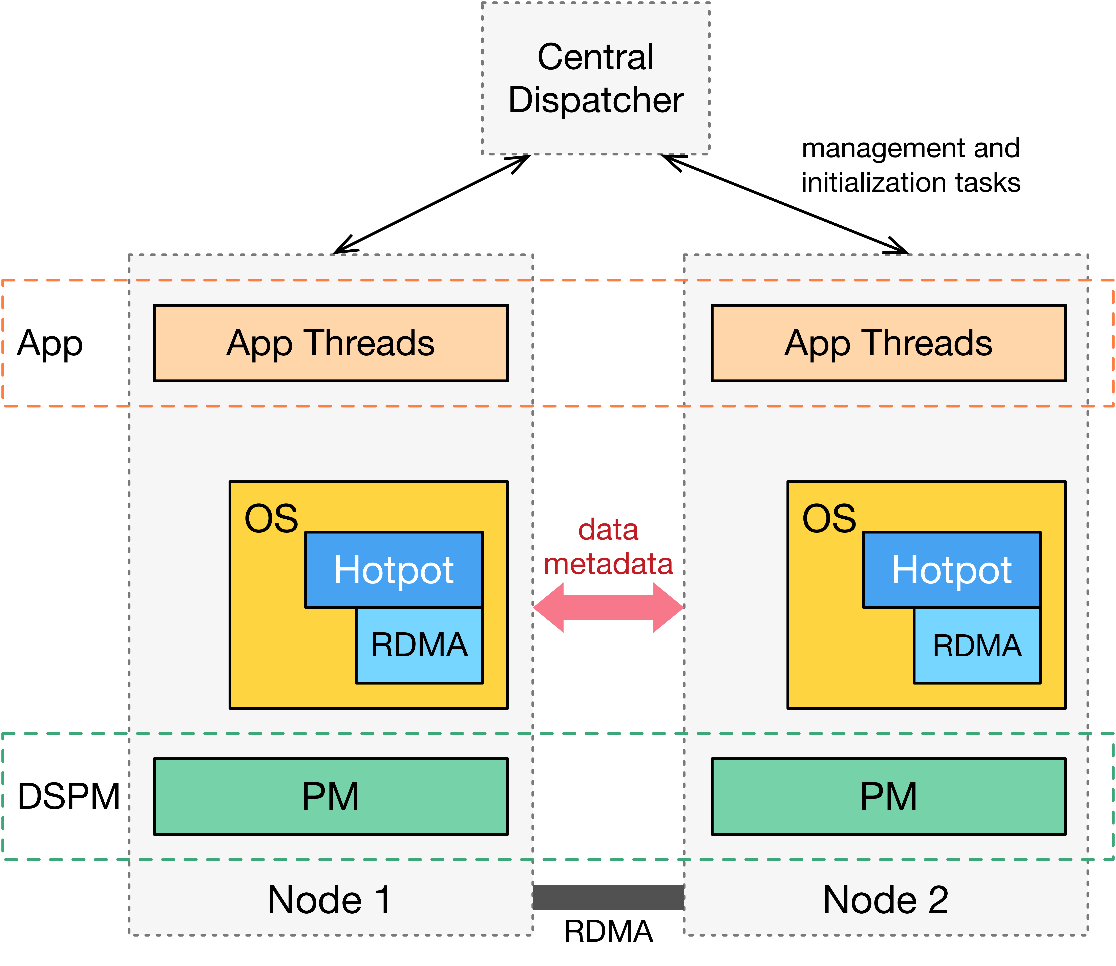
Hotpot Architecture
Notes:
Hotpot sits within the kernel, on top of a customized RDMA-stack we built. Hotpot manages PM on its node, and all the PM form a global physical memory space. Hotpot exports a global virtual address space to application process.

Slide 15
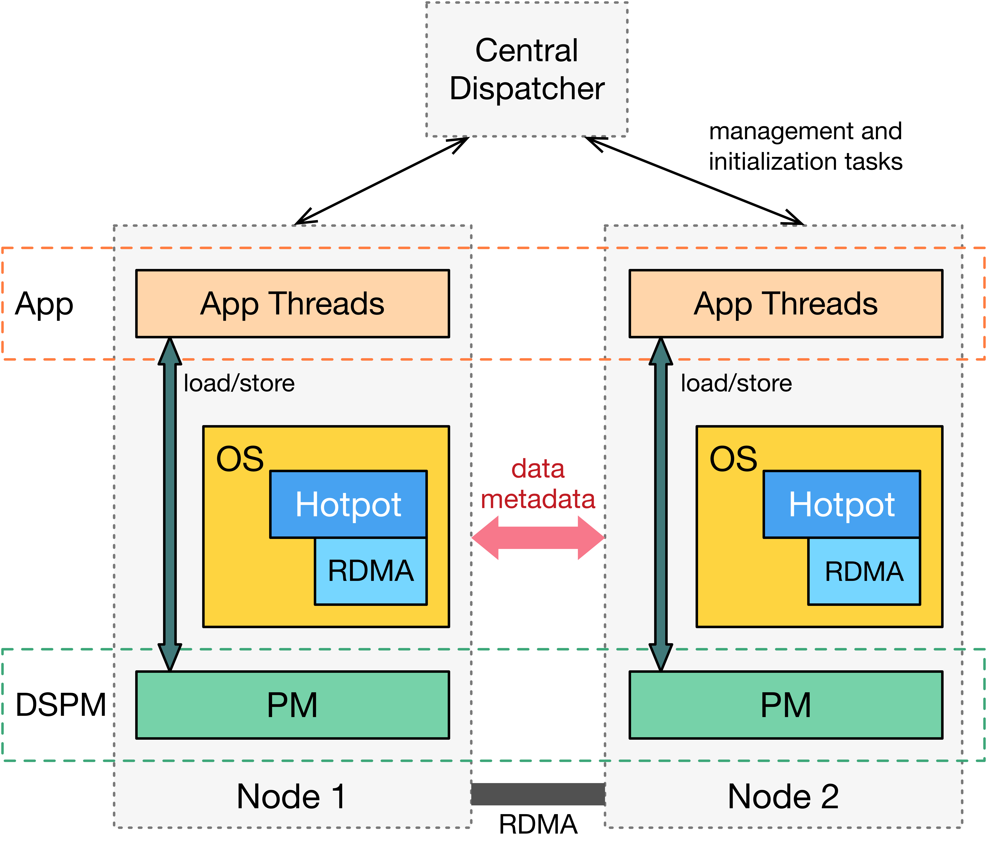
Hotpot Architecture
Notes:
Normally, applications access PM transparently without invoking Hotpot. Hotpot is invoked when there is a page fault. The another time when Hotpot is invoked is when applications explicitly call commit, which I will talk more soon.

Slide 16
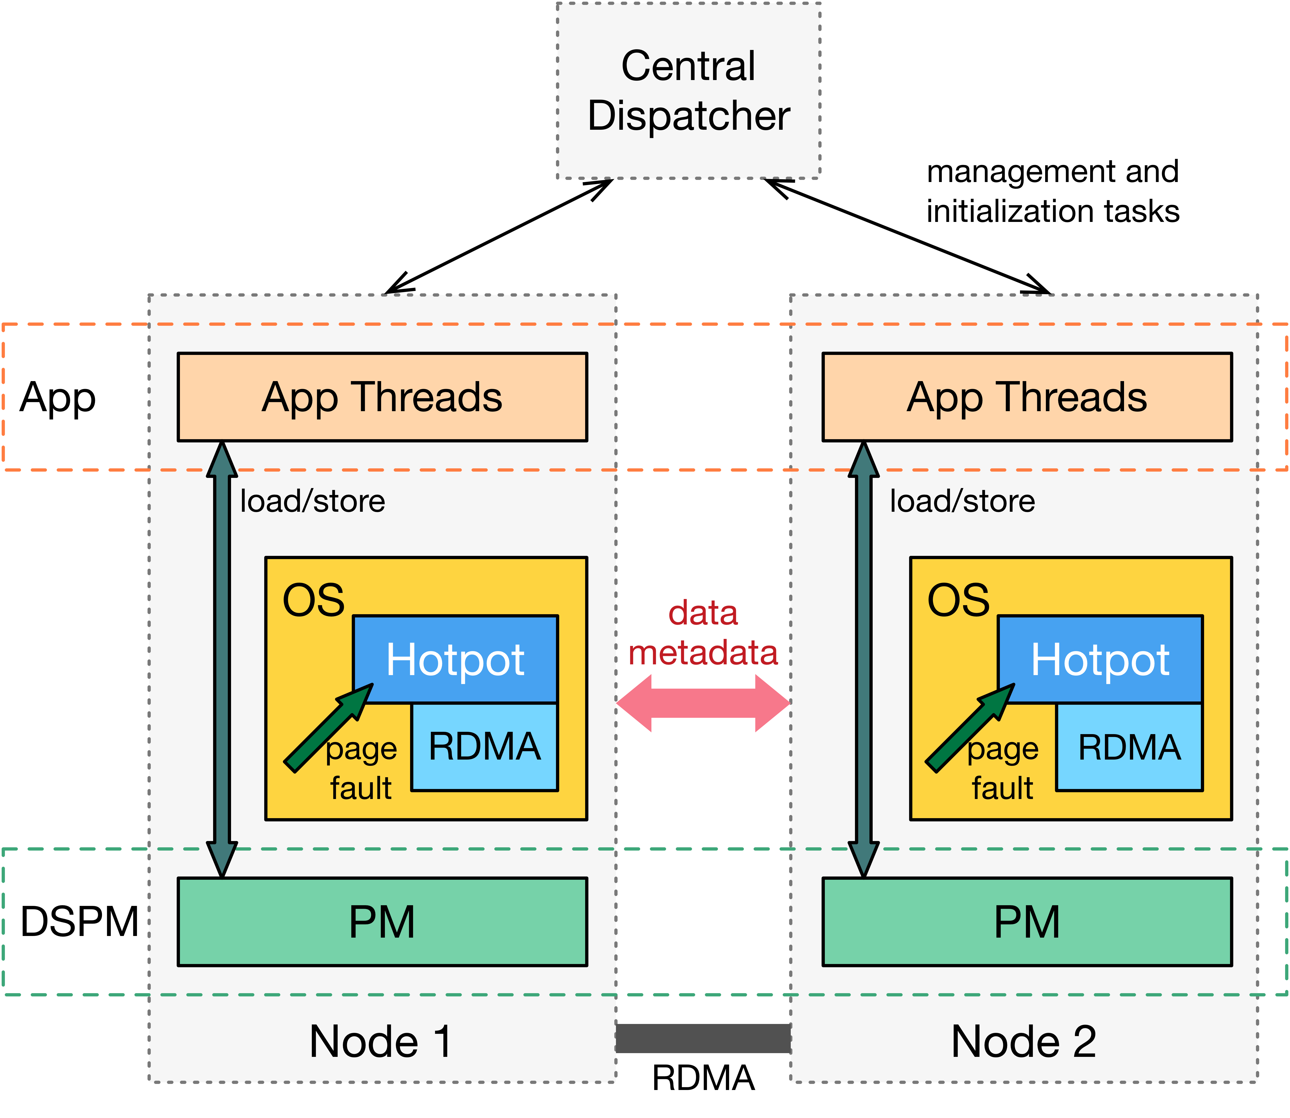
Hotpot Architecture
Notes:
Normally, applications access PM transparently without invoking Hotpot. Hotpot is invoked when there is a page fault. The another time when Hotpot is invoked is when applications explicitly call commit, which I will talk more soon.

Slide 17
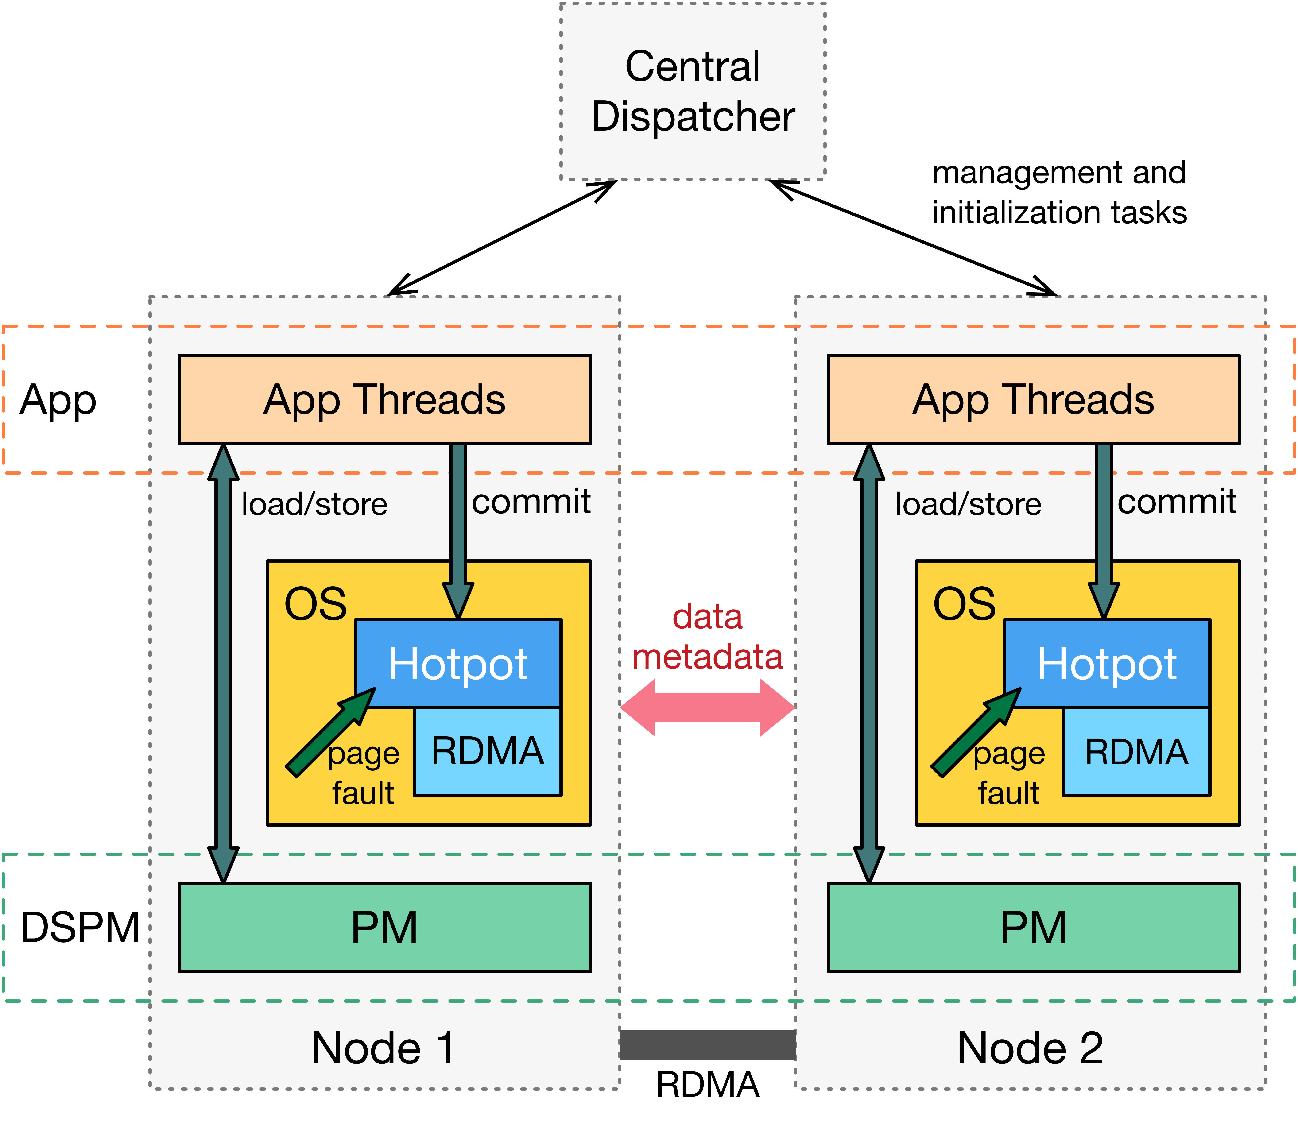
Hotpot Architecture
Notes:
Hotpot is invoked when there is a page fault. The another time when Hotpot is invoked is when applications explicitly call commit, which I will talk more soon.
Now that we understand the overall architecture of Hotpot. Let us see how to use it.

Slide 18
Hotpot Code Example
/* Open a dataset named `socc’, and mmap it to
* application’s virtual address space */
int fd = open(”/mnt/hotpot/socc”, O_CREAT|O_RDWR);
void *base = mmap(0,40960,PROT_WRITE,MAP_PRIVATE,fd,0);
/* First access: Hotpot will fulfill page fault */
*base = 9;
/* Later accesses: Direct memory load/store */
memset(base, 0x27, PAGE_SIZE);
/* Commit data: making data coherent and replicated */
msync(sg_addr, sg_len, MSYNC_HOTPOT);
Notes:
To maintain backward compatibility, we support unmodified open, mmap, msync POSIX APIs.
To use hotpot, users first create or open a dataset, which is a collection of data like a file. After that, you can use a mmap to map the dataset into the application virt addr space.
When the application accesses some data for the first time, Hotpot will be invoked and get the data. Afterwards, all accesses to this data will be direct load/store.
Applications can also use msync() to commit their data, by providing a scatter-gather list of addresses and length.
Hotpot will make cached copies coherent across machines, and create extra replicas.

Slide 19

How to correctly add P to “DSM” without losing performance?
Distributed Shared Memory
Cache remote memory on-demand for fast local access
Multiple redundant copies
Distributed Storage Systems
Actively add more redundancy to provide data reliability
Integrate two forms of redundancy with morphable page states
One Layer Principle
Notes:
Now we’ve looked into the overall architecture and abstraction of Hotpot. So how do we implement it? Our main challenge here is how to correctly adding P into DSM without losing performance. To confront this challenge, we first look back into what DSM is and what distributed storage system is.
If we look at DSM, it has a form of redundancy, which is a result of DSM cache remote memory on-demand for future data access.
As for storage systems, it also has redundancy. But different from DSM, storage systems actively add more redundancy to provide data reliability.
The question for us is: is there any way to integrate these 2 forms of redundancy? Can we use the redundancy that was used for fast access, to also contribute to data reliability?
Our idea here is to integrate these 2 forms of redundancy with morphable page state, which follows our one-layer principle.

Slide 20
Morphable Page States
A PM page can serve different purposes, possibly at different times
as a local cached copy to improve performance
as a redundant data page to improve data reliability
Node 2 accesses page 3
Node 1
Node 2
3
1
3
1
4
2
2
4
3
Notes:
It will be a redundant page to recover data

Slide 21
Morphable Page States: Challenges
Different purposes bring different challenges
Served as cache? Need to handle data coherence
Served as replica? Need to ensure crash consistency
Not simple
Anything wrong lead to (persistent) inconsistent state
New protocols to ensure consistency!
Notes:
It is not easy to implement it correctly.
Hotpot needs to handle coherence of the cached copies
It also needs to ensure data integrity across crash.
Anything wrong will lead to inconisistent state, to make it worse. Those wrong states will be persistent
We designed a set of new protocols to ensure consistency, if you are interested, please check out our paper.

Slide 22
When do we add P to “DSM”?
When shall we:
Make cached copies coherent?
Add reliability and crash consistent?
Observations:
Data-intensive apps have well-defined commit points
Commit points: time to make data persistent
Visible to storage devices => visible to other nodes
Exploit application behaviors:
Conducting coherence events only at commit points
Notes:
The next question … The simplest way… Fortunately,...
Currently, these apps use this point to indicate the time when they want to make their data persistent, which means, they are okay with storage devices seeing this data. We believe, this points also means app will be ok to have their data invisible by other nodes as well. Following this observation, our next key idea is to exploit app behavibours to conduct conherence events at already defined commit points.

Slide 23
Crash Consistency
Single-node Crash Consistency
Cache flush
Persist ordering
Distributed Crash Consistency
Multiple Reader Multiple Writer (MRMW)
Allows multiple concurrent dirty copies (multiple writers)
Great parallelism, but weaker consistency
Three-phase commit protocol using redo and undo logs
Multiple Reader Single Writer (MRSW)
Allows only one dirty copy (single writer)
Trades parallelism for stronger consistency
Single phase commit protocol
Notes:
In hotpot, first of all, we need to ensure single-node crash consistency

Slide 24
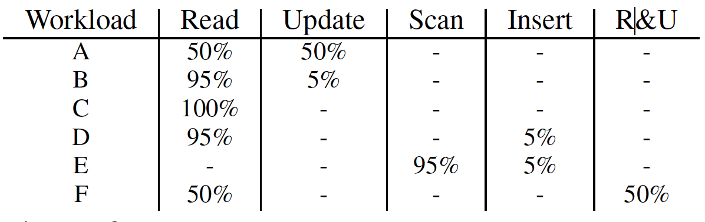
MongoDB Results
Modify MMAPv1 storage engine of MongoDB with ~120 LOC (MRMW)
Evaluate with YCSB, compare with tmpfs, PMFS, Mojim, Octopus

Slide 25
Graph Results
Built a graph engine using PowerGraph design (MRSW)
Run PageRank on Twitter dataset
Compare with PowerGraph and Grappa

Slide 26
Conclusion
Calls for attention to use PM in datacenter
One layer approach: challenges and benefits
Hotpot: a kernel-level RDMA-based DSPM system
Hide complexity behind simple abstraction
Notes:
To conclude, we first want to call for attention to use PM in dc. DSPM is not the only way to use it. We hope more research work can go into this area. We propose DSPM with one-layer approach, based on which we built hotpot, we build it in linux and evaluated with real-applications. W­e paid a lot effort to make things correct within Hotpot. If you are interested, please read our paper. But we hide a lot complexity behind a simple abstraction.

Slide 27

Thank you! Questions?
https://github.com/WukLab/Hotpot
WukLab.io
Notes:
There are a lot interesting stuff in the paper, if you are interested

Slide 28
Backup Slides

Slide 29
Hotpot Data Access Process
Chunk 1
1
Chunk 2
2
3
4
5
Chunk 3
Dataset
fd = open(“/mnt/hotpot/boilerup”, O_CREAT|O_RDWR);
void *base = mmap(0,40960,PROT_WRITE,MAP_HOTPOT,fd,0);
memcpy(buf1, base+3*4096, 10);
memcpy(base+8*4096, buf2, 20);
Node 1 (Owner of Chunk2)
Node 2
3
3
5
1
4
2
2
4
4

Slide 30
Hotpot Data Access Process
Chunk 1
Chunk 2
Chunk 3
Dataset
Update Page4 cached copy,
counts as one replica
Node 3
3
4
morphable
page state
4
Page3 as a replica
Node3 access Page3 locally, becomes active
commit(base, 3); // 3 replicas
Node 1 (Owner of Chunk2)
Node 2
3
3
3
5
1
4
4
2
2
4
4
3
3

Slide 31
MRMW Data Commit Process
update
commit
Node 1
Node 2
Node 3
Node 4
Phase 1
Phase 2
Phase 3
Metadata
Data
Notes:
Node 1 is the committing node, it locally has 2 pages, the gray one is clean-copy, the colored ones are dirty-copy.
Node 2 and node 3 are the homenode of these 2 pages.
Phase 1, node 1 will send dirty pages to node 2 node 3, which will create a persistent redo-log.
Node 1 will proceed to phase 2 if and only if both node 2 and node 3 reply success.
Phase 2, node 1 just send a command to 2 and 3.
Prep

Slide 32
Morphable Page States
Active page means it is mapped into VA space
Inactive
Active
Clean page has not been updated since last commit
Clean
Dirty
Inactive + Clean = Redundant PM page
Active + Dirty = Dirty Cached PM page
Active + Clean = Clean Cached PM page
Notes:
Morphabale page states means one PM page can serve one purpose at a time, and another purpose at another time. These states can change with various activities.
It is not simple, because we need to first take care of coherence, which is a result of multiple copies that applications can access, and applications want to access them in a coherent way. That is the traditional coherence DSM systems provide. And with the same form of redundancy, we should also make sure data is reliable even when failure happens. The interesting thing is when failure happens, if we are not careful, not only make inconsistent states, but worse the states will be persistent.

